Slide 1
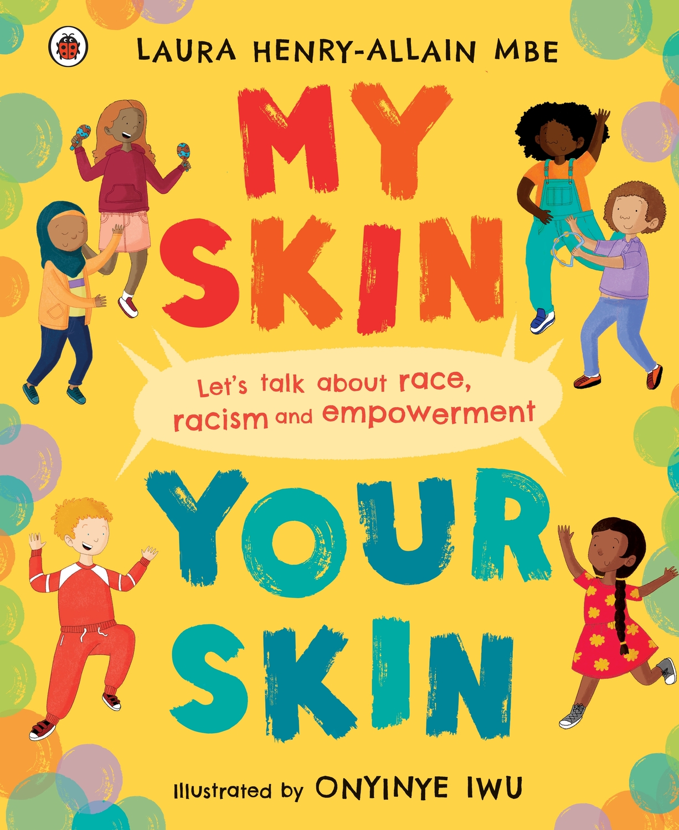
Key Stage 1 resource
My Skin, Your Skin
By Laura Henry-Allain MBE, illustrated by Onyinye Iwu
Illustrations by Onyinye Iwu. Copyright © Ladybird Books, 2021

Slide 2
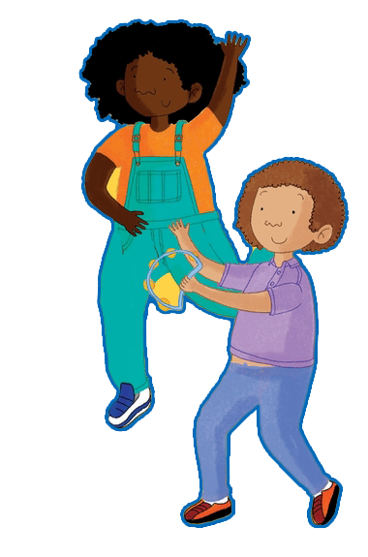
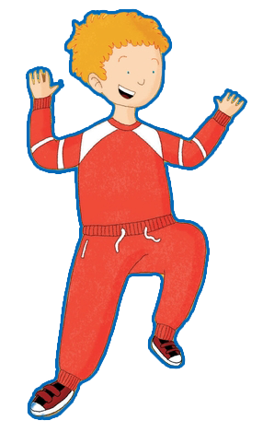
Activities
‘My Skin, Your Skin’ is the perfect book to open up meaningful discussions about race and anti-racism. Most importantly, the book empowers children to be the best versions of themselves; to have self-love, self-esteem and self-worth, irrespective of their skin colour.
Illustrations by Onyinye Iwu. Copyright © Ladybird Books, 2021
Activity One – What makes you unique?
Explore our differences and reflect on what makes us unique
Activity Two – Let’s talk racism
Understanding racism, why it is wrong and what to do if they experience or see racism
Activity Three – Let’s talk empowerment
Reflect on why we are special and what we are good at

Slide 3
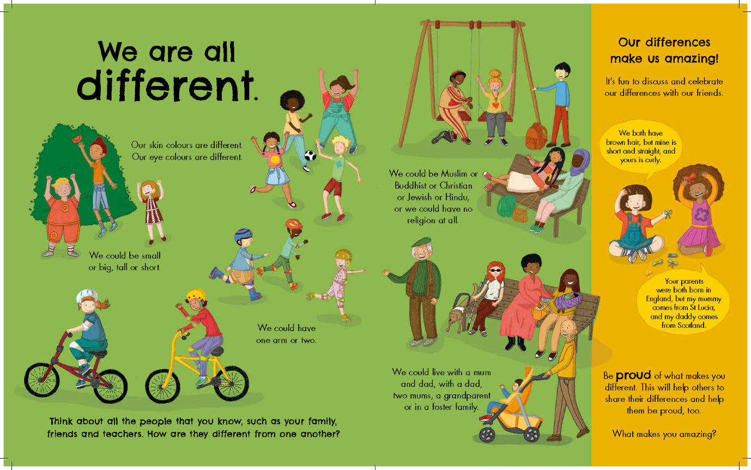
What makes you unique?
Everyone is different and that makes them unique. Look at the final page of My Skin, Your Skin on the right. What do each of the three statements mean below?
I am great
My skin is beautiful
I am unique
Illustrations by Onyinye Iwu. Copyright © Ladybird Books, 2021
Notes:
When looking at the final page, encourage and support children with their understanding on faith and religion. Sikhism, Hinduism, Judaism, Rastafarianism, Muslim, Buddhism, Christianity, etc.
This includes people who may not have a religion.
Then, look at the three statements:
I am great
My skin is beautiful
I am unique
Ask the children about each statement, for example, what does it mean to be great? What makes you unique? Use this page to explore how we are all different. As a teacher, join in and share your differences. They may use words: they are great at being kind to their friends, they are great at reading, they are great listeners. You may have to prompt them.

Slide 4
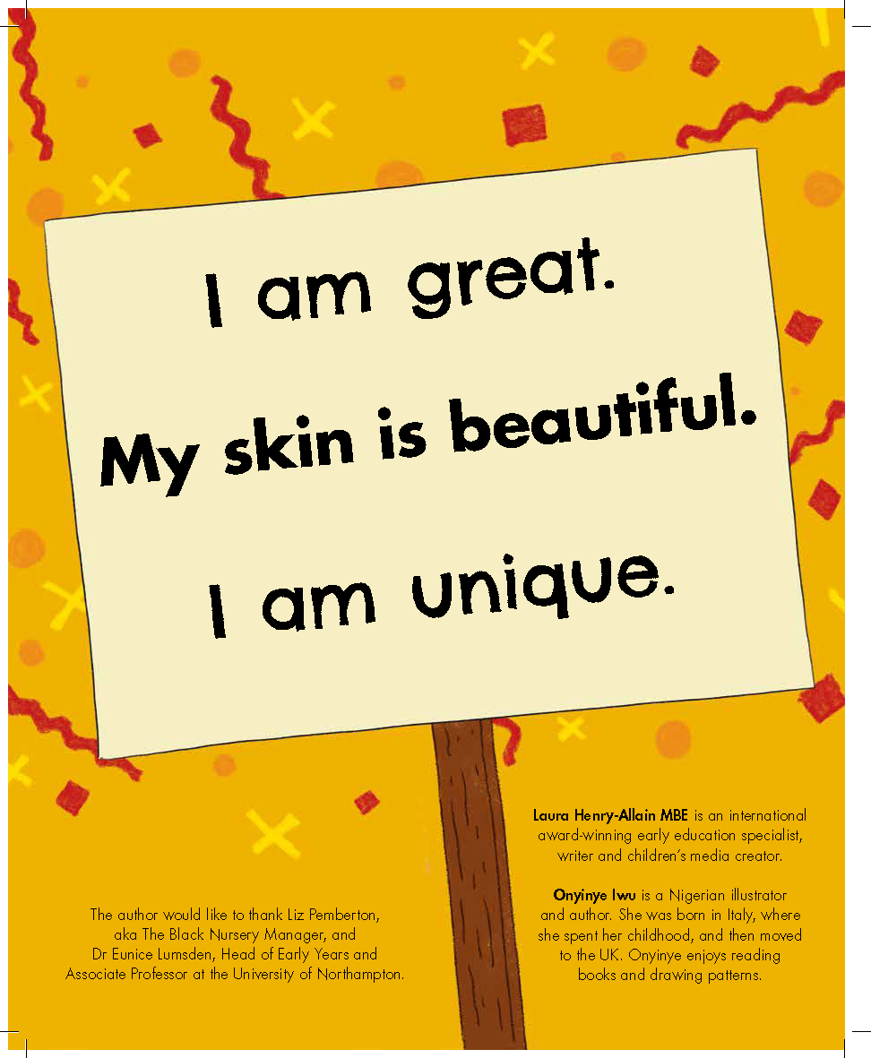
What makes you unique?
Describe your beautiful skin
What is beautiful about it? Do you have freckles? Moles? Birthmarks?
Finally, what makes you unique?
Illustrations by Onyinye Iwu. Copyright © Ladybird Books, 2021
Notes:
Ask them to describe their beautiful skin.
They may use words: they are great at being kind to their friends, they are great at reading, they are great listeners. You may have to prompt them.
Reflecting on their skin tone, what is beautiful about their skin? Do they have freckles? Moles? Birthmarks? Their skin is still beautiful.
Finally, what makes them unique?

Slide 5
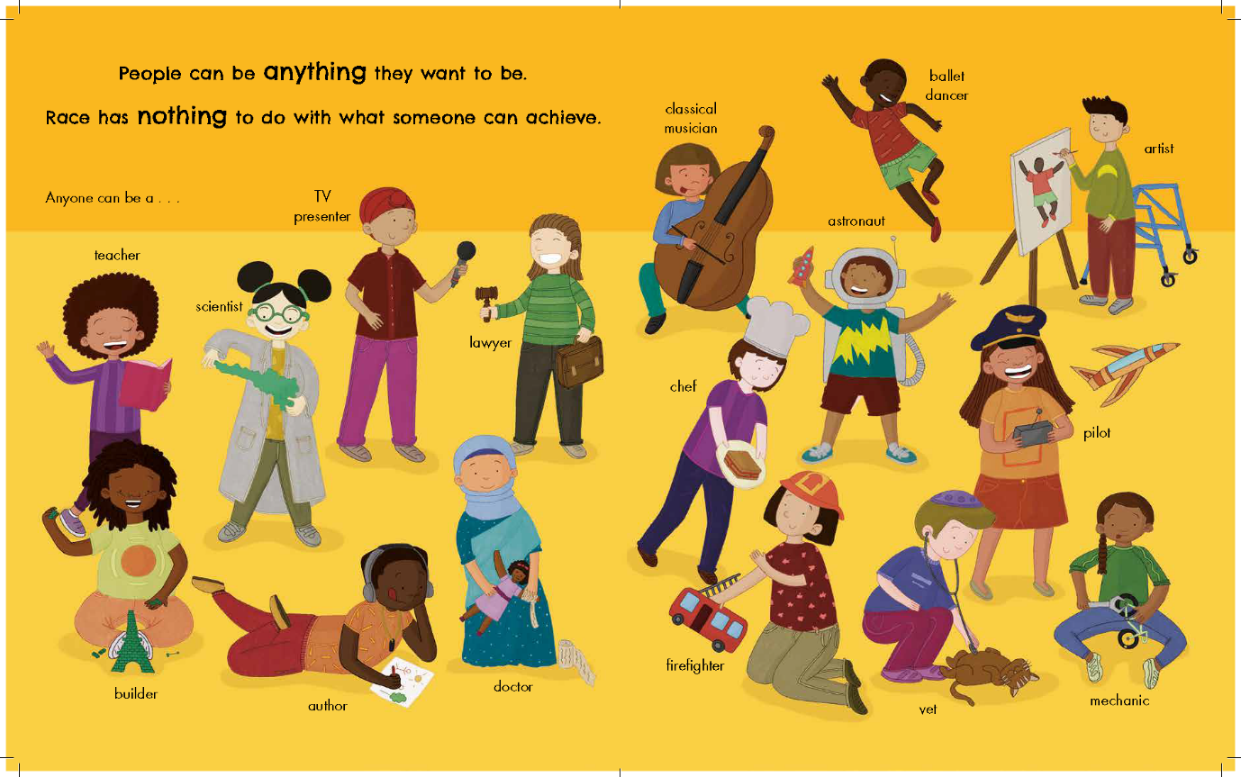
What makes you unique?
Let’s explore your uniqueness.
What do you like doing in school and out of school?
What is your passion? What are your hobbies?
Illustrations by Onyinye Iwu. Copyright © Ladybird Books, 2021
Notes:
Support the children to explore their uniqueness. Celebrate their hair and facial features. What do they like doing in school and out of school? What is their passion? What are their hobbies?
Ask them to reflect on their family background: show the map of the world. Where are their families from? Highlight that we all have a place of origin, and their grandparents or great grandparents may have come to the UK or from somewhere else. Isn’t it great that all our families are different and wonderful, just like us! Use the page showing that people can be anything they want to be.
*I would be very sensitive here. Please feel free to leave this section if it is likely to be too much of a trigger for some of the children, or feel free to adapt accordingly and support children where need be.

Slide 6
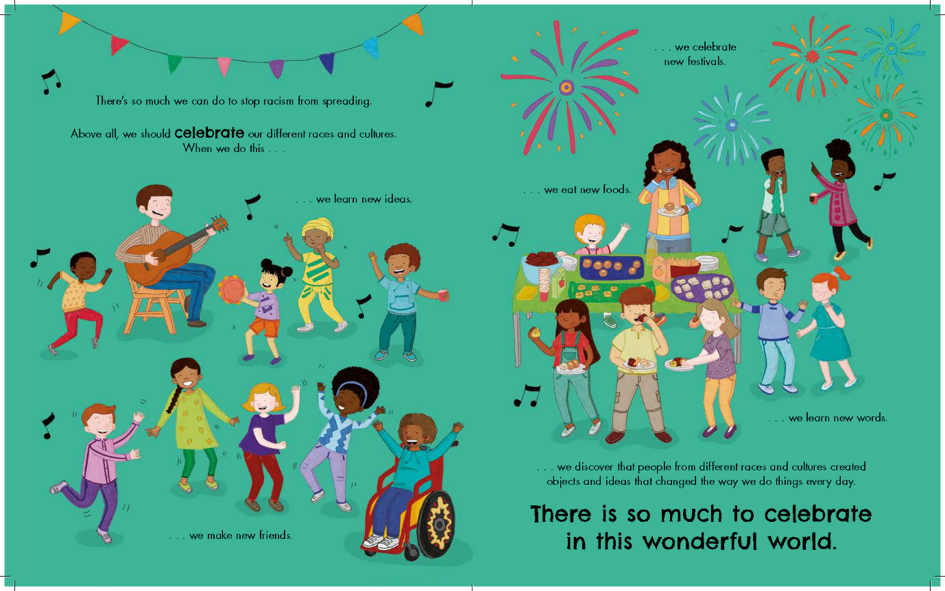
What makes you unique?
Write about, draw or use a symbol to show your greatness, your beautiful skin and what makes you unique.
Illustrations by Onyinye Iwu. Copyright © Ladybird Books, 2021
Notes:
Ask children to write about, draw or use a symbol to show their greatness, their beautiful skin and what makes them unique. Please see the unique template for children to use or they can use their own workbooks.
Please share with the children the ‘Being unique’ resource sheet, and support where needed.

Slide 7
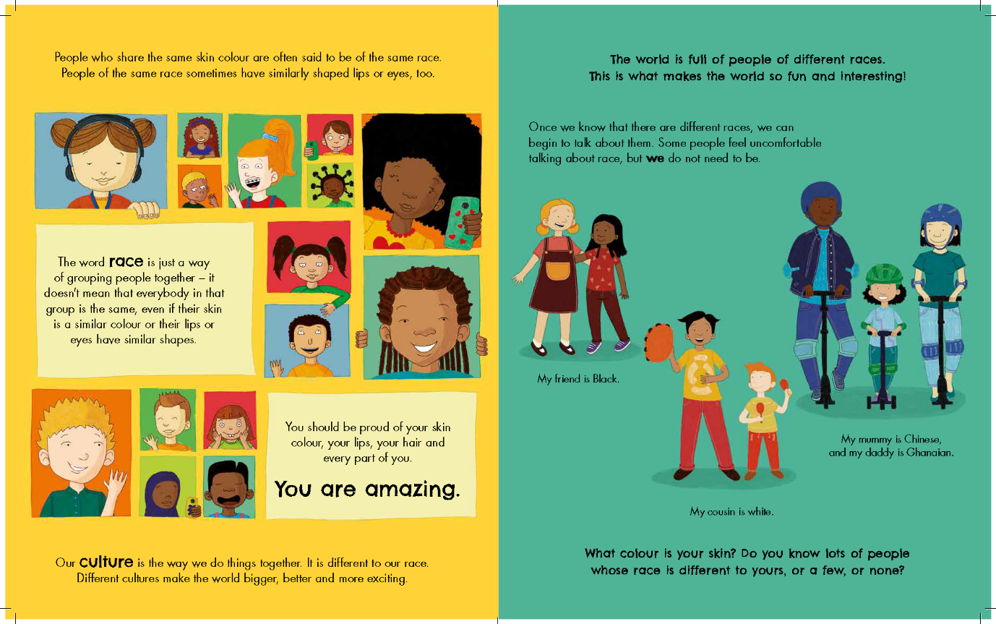
Let’s talk racism
Why is racism wrong and what must we do if we experience racism or see racism?
Illustrations by Onyinye Iwu. Copyright © Ladybird Books, 2021
Notes:
Start by explaining what race is and that we are all different.
Re-read the page on race. Point out the differences in skin colour and facial features with the children. Using the whiteboard or board, encourage children to use words to describe their complexion and visual differences and list them. For example, some of us have freckles, some of us have birthmarks, some of us have straight hair, some of us have curly hair.
Explore why racism is wrong and what they must do if they experience racism or see racism.
Maybe share some examples: calling someone a name because of their skin colour is wrong, excluding someone from a game because of their skin colour is wrong.

Slide 8
Let’s talk racism
What does it mean to be anti-racist?
As a class, what you we going to do about this?
Illustrations by Onyinye Iwu. Copyright © Ladybird Books, 2021
Notes:
Show the wall page, dismantling racism.
You may wish to go into more detail on the word dismantle. Perhaps ask the children what they think the word means first.

Slide 9
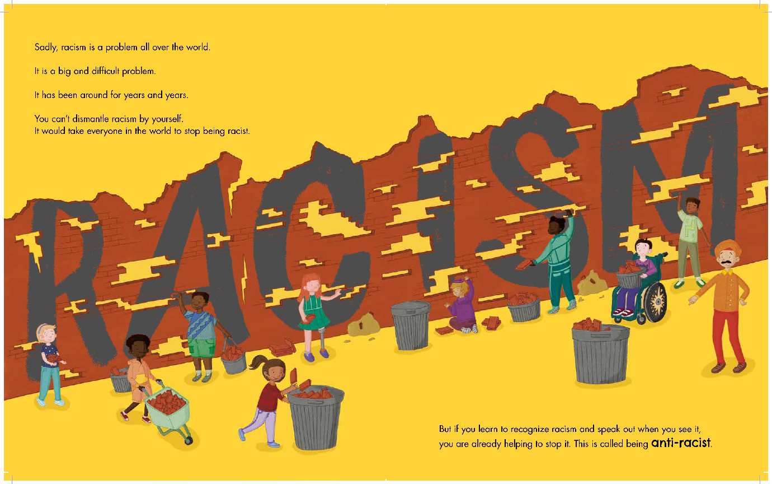
Let’s talk racism
Let’s make a personal and whole-class commitment to be anti-racist. Our commitments:
welcoming others
trying new things
enjoying different celebrations
Illustrations by Onyinye Iwu. Copyright © Ladybird Books, 2021
Notes:
Start to make a personal and whole-class commitment to be anti-racist, for example, welcoming others, trying new things, enjoying different celebrations.
Why not create a class anti-racist board where the children can display their words and suggestions?
Share with the children the ‘Being anti-racist racist’ resource sheet and support them where needed.
Depending on the resources in your school, consider asking the children to build a brick wall and then ask them to dismantle the bricks as a symbolic illustration of dismantling the wall.

Slide 10
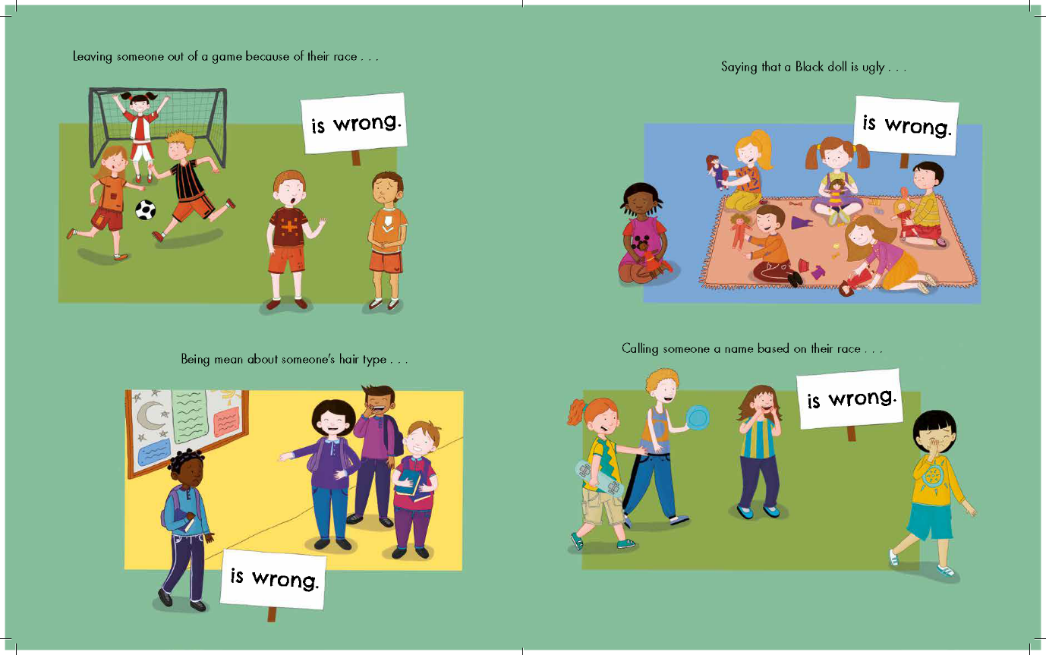
Let’s talk empowerment
What does empowerment mean?
When we are talking about anti-racism, we must be able to speak up and say it is wrong.
Illustrations by Onyinye Iwu. Copyright © Ladybird Books, 2021
Reflection: Why do we think we find race and racism difficult to discuss at school and at home?
Notes:
Start a discussion with the children about the meaning of empowerment. You might wish to define it as the children having the power to have a voice and be in control and taking responsibility for their behaviour.
When we are talking about anti-racism, we must be able to speak up and say it is wrong.
Share this page to illustrate your point and maybe encourage the children to join in with you.
Furrher reflection: Why do we think we find race and racism difficult to discuss at school and at home?

Slide 11
penguin.co.uk/litincolour

