Slide 1
KS1/2 Art
Hey You!
By Dapo Adeola and eighteen talented Black illustrators:
Hey You! cover illustration © Dapo Adeola, 2021. Typography © Alyissa Johnson, 2021.
Alyissa Johnson
Jade Orlando
Reggie Brown
Chanté Timothy
Sharee Miller
Diane Ewen
Onyinye Iwu
Gladys Jose
Bex Glendining
Dunni Mustapha
Charlot Kristensen
Camilla Sucre
Jobe Anderson Joelle Avelino Nicole Miles Kingsley Nebechi Derick Brooks
Selom Sunu

Slide 2
Activities
Activity One – Photo Frame Wall
Inspired by spread 2 – fill a photo frame wall with pictures of the family/friends/people who are important to you
Activity Two – Choose your own path
Inspired by spread 6 – dream big and draw yourself in your dream role
Activity Three – What’s your superpower?
Inspired by spread 16 –reflect on your superpowers (positive character traits) and design your own superhero mask
Hey You! cover illustration © Dapo Adeola, 2021. Typography © Alyissa Johnson, 2021.

Slide 3
Hey You! text © Dapo Adeola, 2021. Illustration © Jade Orlando, 2021.

Slide 4
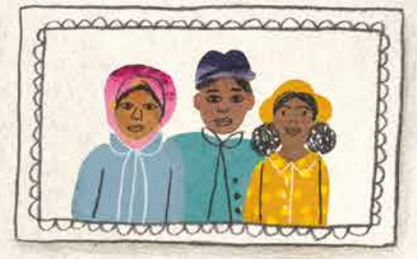
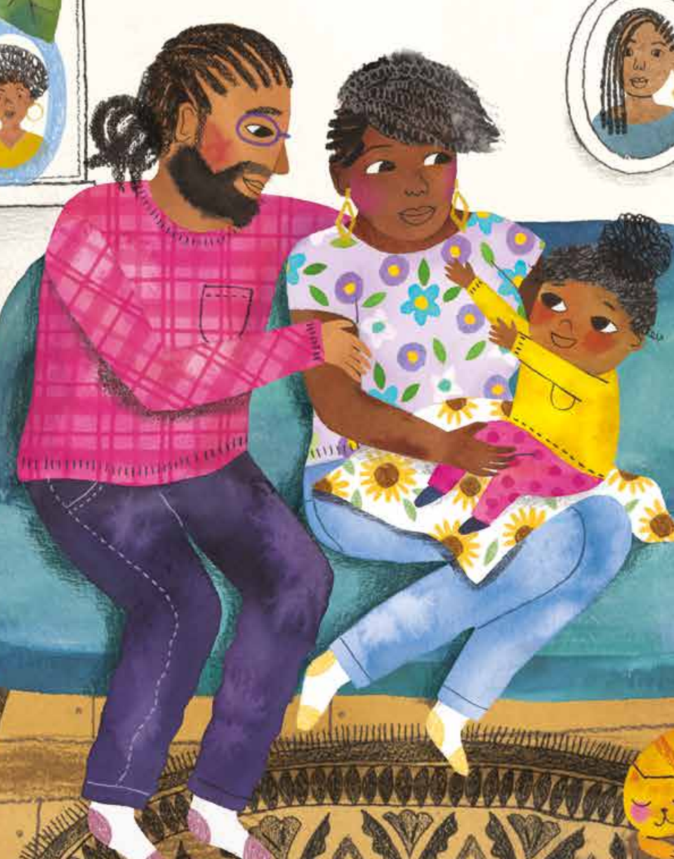
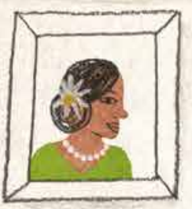
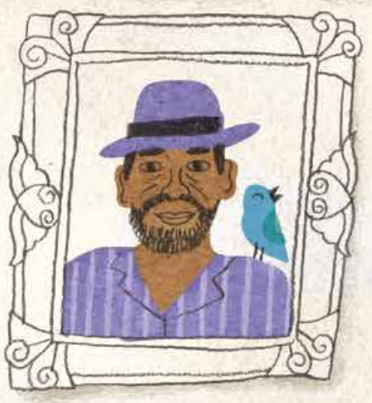
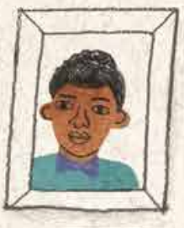
Activity One
Think about the people around you, your friends and your family. Who do you love and who loves you?
Fill in the empty frames with their faces and create your own picture gallery of people who love you just for being you!
I hope
know that you
are
Hey You! text © Dapo Adeola, 2021. Illustration © Jade Orlando, 2021.

Slide 6
Hey You! text © Dapo Adeola, 2021. Illustration © Chanté Timothy, 2021.

Slide 7
Activity Two
Discuss
Dream Big!
You can be whatever you want to be and you always have a choice. Don’t let the views of others hold you back. Believe in yourself and follow your dreams!
1. What would you like to be when you grow up?
2. Can you spot your choice on the left?
3. Do you know the path you could take to get there?
sportsperson
police officer
barrister
singer
chef
pilot
doctor
artist
nurse
lawyer
You your own path in life
and can be whatever you want to be
vet
detective
Hey You! text © Dapo Adeola, 2021. Illustration © Chanté Timothy, 2021.
architect
firefighter
doctor
teacher

Slide 8
Dream
Look into the future and draw yourself in your dream job

Slide 9
Hey You! text © Dapo Adeola, 2021. Illustration © Jobe Anderson, 2021.

Slide 10
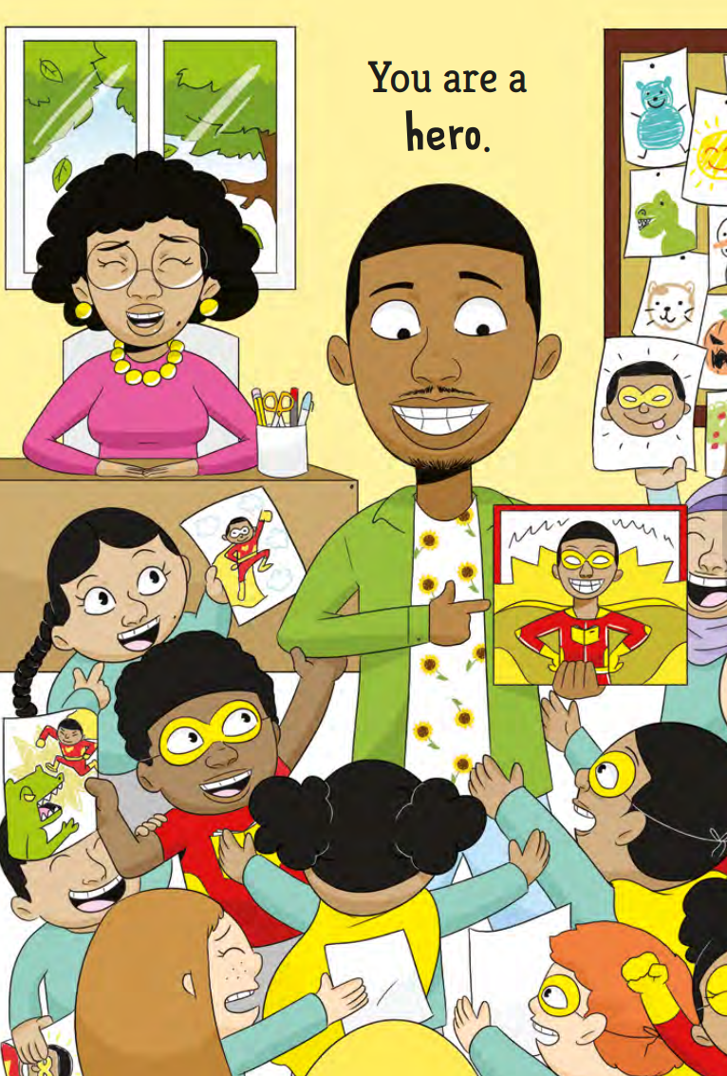
kindness
loyalty
friendliness
honesty
dependability
resilience
respectfulness
pride
courage
empathy
optimism
energy
humour
confidence
creativity
cheerfulness
positivity
reliability
Activity Three
have your own incredible
superpowers that make unstoppable
Look at the list of positive character traits. These are our superpowers. By displaying these attributes in our everyday lives, we can help ourselves and others achieve greatness.
Which ones do you most identify with? What are your superpowers?
How do you show them?
Design your own superhero mask and remember that you are unstoppable!
Hey You! text © Dapo Adeola, 2021. Illustration © Jobe Anderson, 2021.

Slide 12
penguin.co.uk/litincolour

