Slide 1
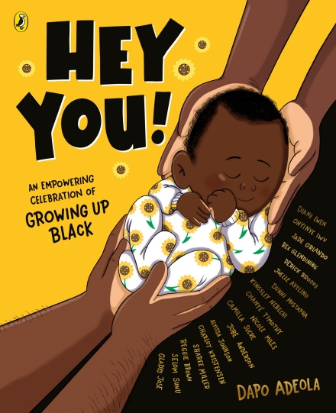
KS1 Reading
Hey You!
By Dapo Adeola and eighteen talented Black illustrators:
Hey You! cover illustration © Dapo Adeola, 2021. Typography © Alyissa Johnson, 2021.
Alyissa Johnson
Jade Orlando
Reggie Brown
Chanté Timothy
Sharee Miller
Diane Ewen
Onyinye Iwu
Gladys Jose
Bex Glendining
Dunni Mustapha
Charlot Kristensen
Camilla Sucre
Jobe Anderson Joelle Avelino Nicole Miles Kingsley Nebechi Derick Brooks
Selom Sunu

Slide 2
Activities
‘Hey You’ is the perfect book to open up discussions about race and allyship with even our youngest learners.
Activity One – You are loved
Use spread 2 to discuss the meaning of love and belonging with your class. Read the text together, then break it down to discuss the effect on the reader.
Activity Two – You are wonderful
Use spread 3 to discuss the idea of self-worth and self-esteem with your class.
Activity Three – Love your beautiful skin
Use spread 4 to facilitate a discussion on diversity and equality with your class.
Hey You! cover illustration © Dapo Adeola, 2021. Typography © Alyissa Johnson, 2021.

Slide 3
Starter
Show the cover and discuss the following questions:
Looking at the title and sub heading
What do you think this book is about? Why?
Looking at the illustration
What can you see?
Does the baby look happy or sad. Why?
Whose hands do you think are holding the baby?
Looking at the eighteen illustrator names
A front cover usually has the names of an author and an illustrator on it. Why do you think there is a long list of names on the cover? Introduce the idea of a collaboration, when people work together on a project.
Hey You! cover illustration © Dapo Adeola, 2021. Typography © Alyissa Johnson, 2021.

Slide 4
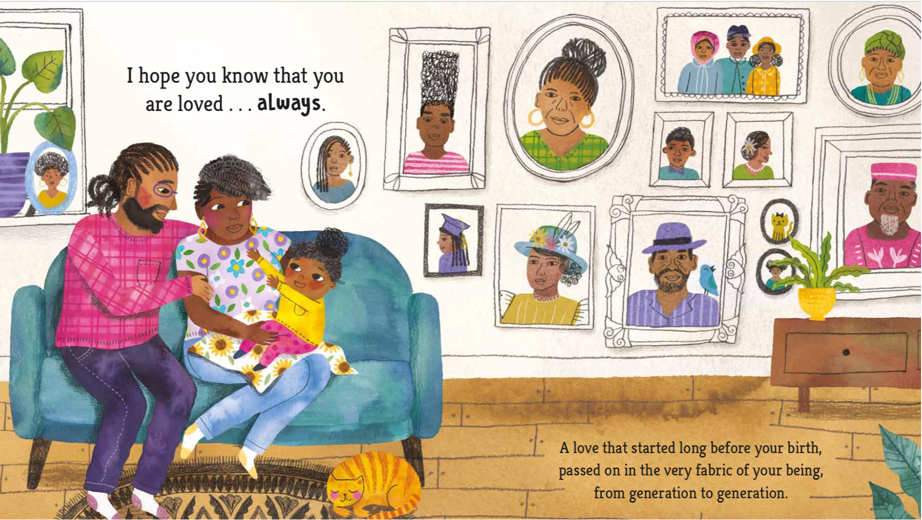
Illustration inference
1. Who is sitting on the sofa?
2. What do you think the relationship between the three people is and why?
3. How do you think they feel about each other and why?
4. Who do you think the pictures on the wall are of and why?
Hey You! text © Dapo Adeola, 2021. Illustration © Jade Orlando, 2021.
Vocabulary check
‘Generation’
Do you know the meaning of the word generation? Have you heard the word before?
Phrase Meaning
‘Fabric of your being’
What do you think this phrase means? Can you give examples relating to yourself?
People born and living around the same time
Every single part of you, including your history and family

Slide 5
You are loved
1. Why is it important to
know that you are loved?
2. How does it make you feel?
3. How can love begin before you are even born?
4. What do you think Dapo meant by this?
Hey You! text © Dapo Adeola, 2021. Illustration © Jade Orlando, 2021.
Can you think of any synonyms for love? List them as a class.

Slide 6
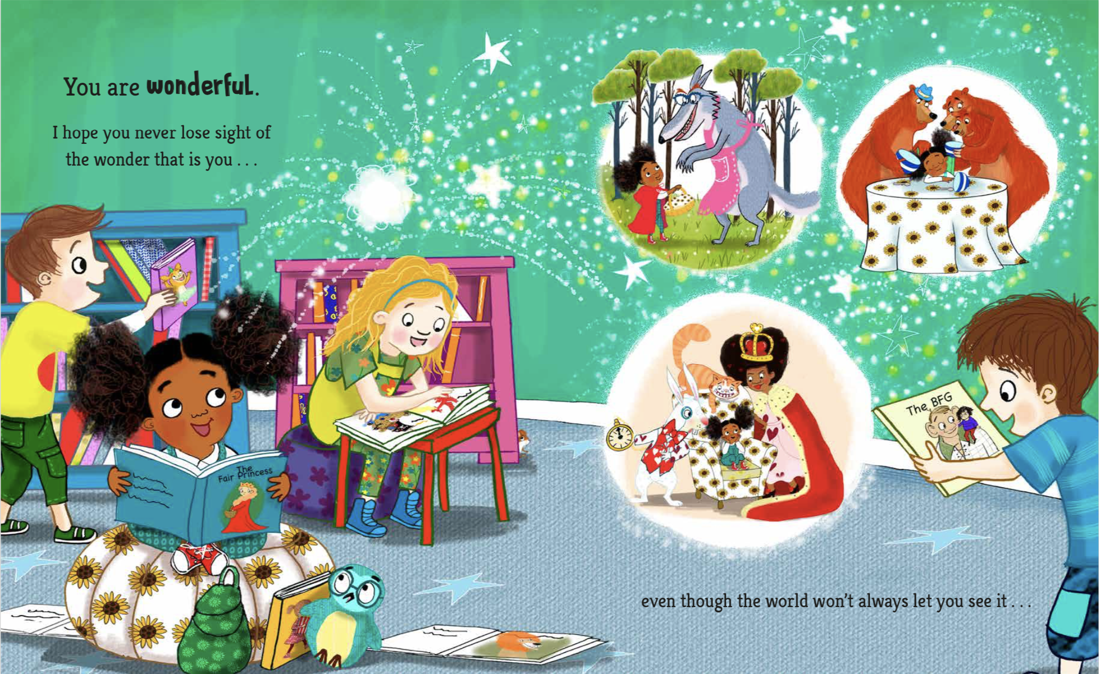
Illustration inference
Where do you think this scene
is taking place? Can you explain
why you think that?
2. How do you think the
children are feeling?
3. What has the illustrator done to
make you think that way?
4. What is the little girl in the front imagining? Discuss the importance of representation in books.
Hey You! text © Dapo Adeola, 2021. Illustration © Diane Ewen, 2021.
Vocabulary check
‘Wonderful’
Do you know the meaning of the word wonderful? Have you heard the word before? Can you think of other words that could be used instead of wonderful that have the same meaning?
Phrase Meaning
‘never lose sight’
What do you think this phrase means?
Never forget something or someone
Extremely good

Slide 7
You are wonderful
What makes you wonderful?
Think about your own special qualities and tell a friend all about them. Then, tell your friend some amazing things about them too. It will definitely make them smile!
Think about why ‘the world’ won’t always let you see your wonder. Who do you think ‘the world’ could be?
Hey You! text © Dapo Adeola, 2021. Illustration © Diane Ewen, 2021.

Slide 8
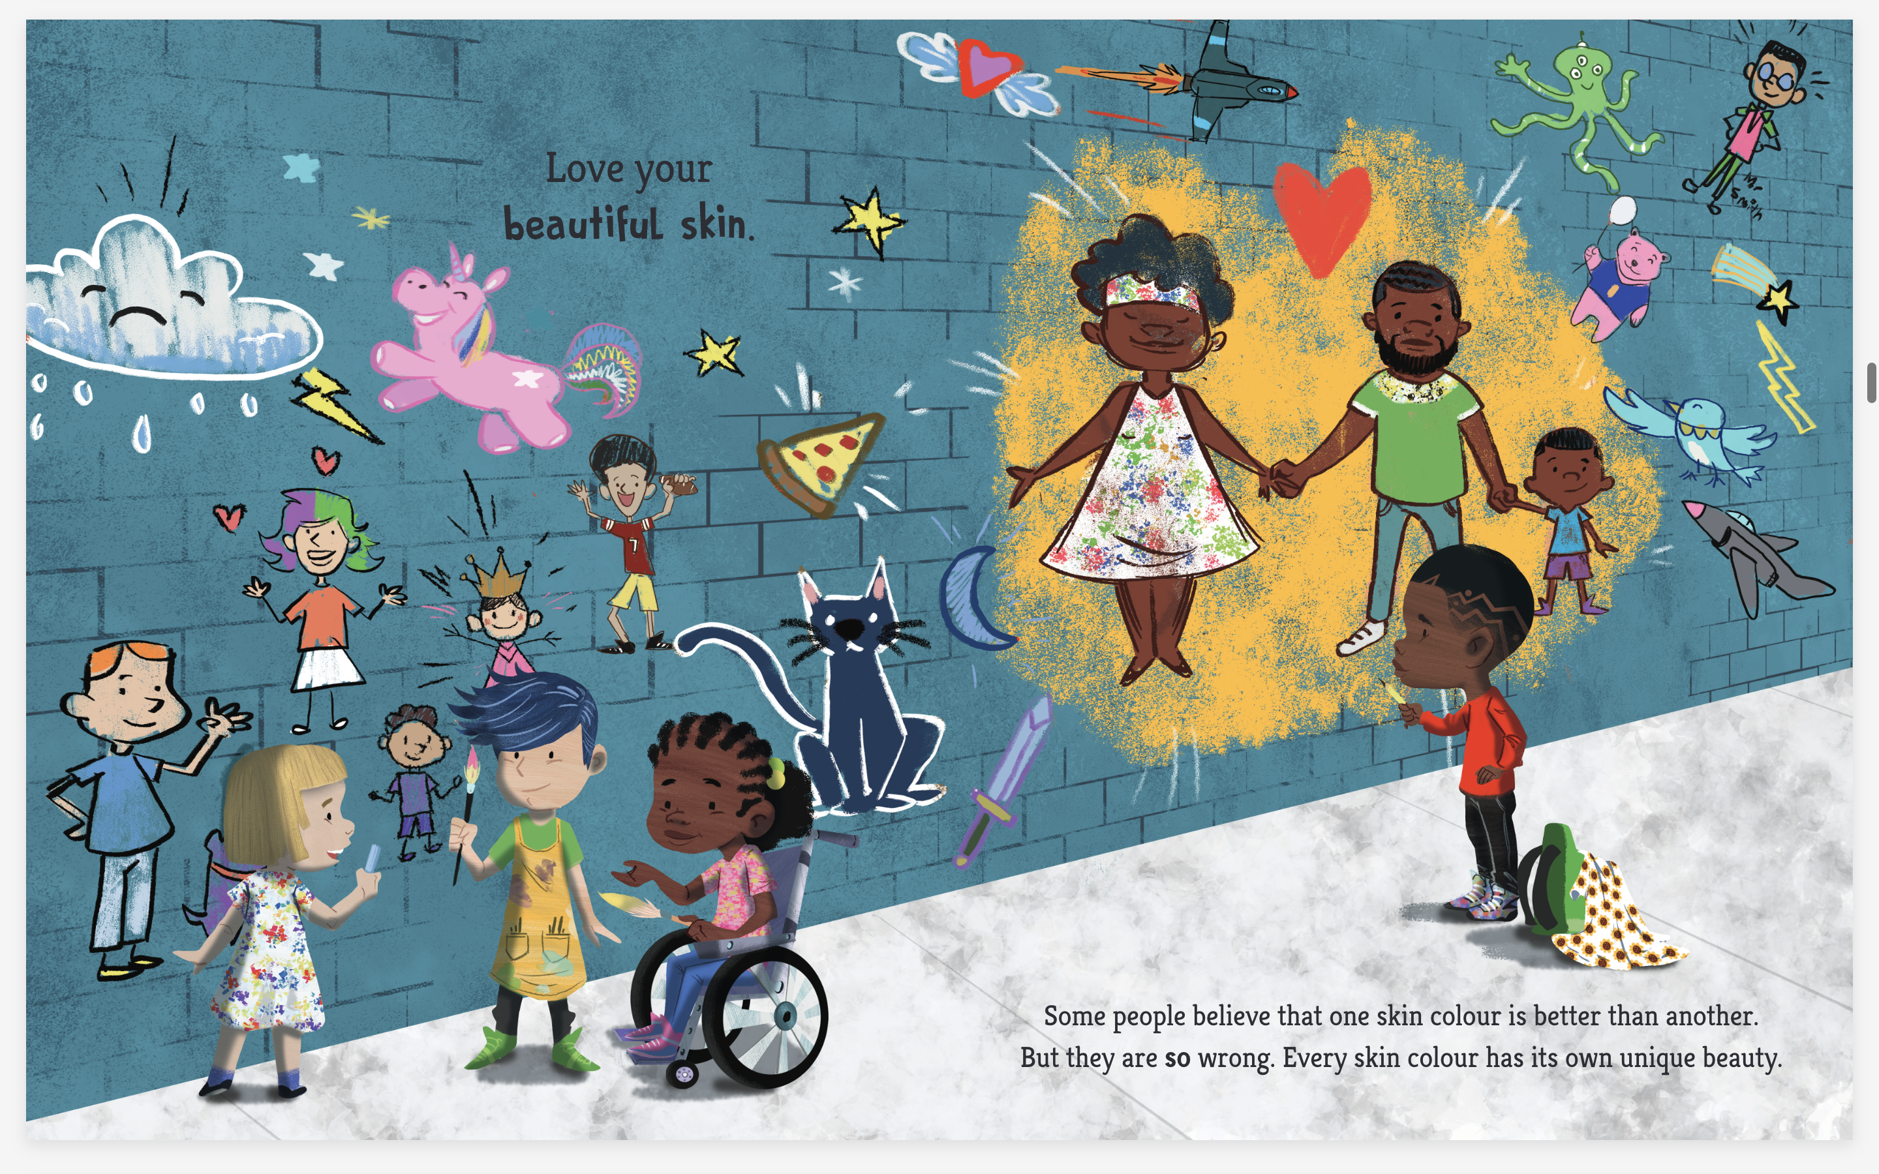
Illustration inference
1. Where do you think this scene is taking place? Can you explain why you have come to that conclusion?
2. Who do you think the little boy
has drawn? Why do you think that?
3. Do you think the group of three
children are friends? What has the illustrator drawn them doing that
makes you think that?
Hey You! text © Dapo Adeola, 2021. Illustration © Reggie Brown, 2021.
Vocabulary check
Unique
Do you know the meaning of the word unique?
Have you heard the word before?
Why do you think the word ‘so’ is in bold?
What does Dapo want to convey to the reader by doing this?
Can you think of any other words he could have used?
The only one of its kind
Can you put this word in a sentence?

Slide 9
Love your beautiful skin
Dapo tells us to ‘love our beautiful skin’ regardless of colour.
All skin is unique and beautiful.
If we hear people acting negatively towards someone because of the colour of their skin we need to call it out. This is called being an ‘ally’.
Hey You! text © Dapo Adeola, 2021. Illustration © Reggie Brown, 2021.
Discuss: ‘Some people
believe that one skin colour
is better than another.’

Slide 10
Reflection
How do you feel now you’ve reached the end of the book?
Can you think of a word to describe your feelings?
Can you put your thoughts and feelings into a couple of sentences and share it with your friends?
Look at the word bank below to help you.
Hey You! cover illustration © Dapo Adeola, 2021. Typography © Alyissa Johnson, 2021.
comfortable
uncomfortable
free
curious
powerful
thoughtful
happy
special
loved
proud
empowered
hopeful
enlightened
unique
wonderful
sad
beautiful

Slide 12
penguin.co.uk/litincolour

