Slide 1
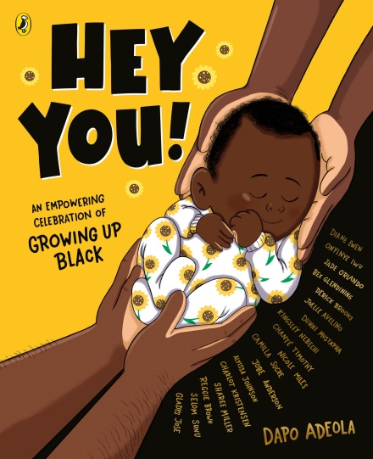
KS2 Reading
Hey You!
By Dapo Adeola and eighteen talented Black illustrators:
Hey You! cover illustration © Dapo Adeola, 2021. Typography © Alyissa Johnson, 2021.
Alyissa Johnson
Jade Orlando
Reggie Brown
Chanté Timothy
Sharee Miller
Diane Ewen
Onyinye Iwu
Gladys Jose
Bex Glendining
Dunni Mustapha
Charlot Kristensen
Camilla Sucre
Jobe Anderson Joelle Avelino Nicole Miles Kingsley Nebechi Derick Brooks
Selom Sunu

Slide 2
Activities
‘Hey You’ is the perfect book to open up discussions about diversity and feeling proud of your heritage and identity.
Activity One – Respond to Dapo’s letter
Read and respond Dapo’s letter to the reader, including outlining their hopes for future generations and how they can contribute to his dream.
Activity Two – Inferring feelings from illustrations
Identify, describe and justify how the characters in the book are feeling.
Activity Three – Wonderful words
Understand melanin, culture, heritage and celebrate your own history and ancestors.
Hey You! cover illustration © Dapo Adeola, 2021. Typography © Alyissa Johnson, 2021.

Slide 3
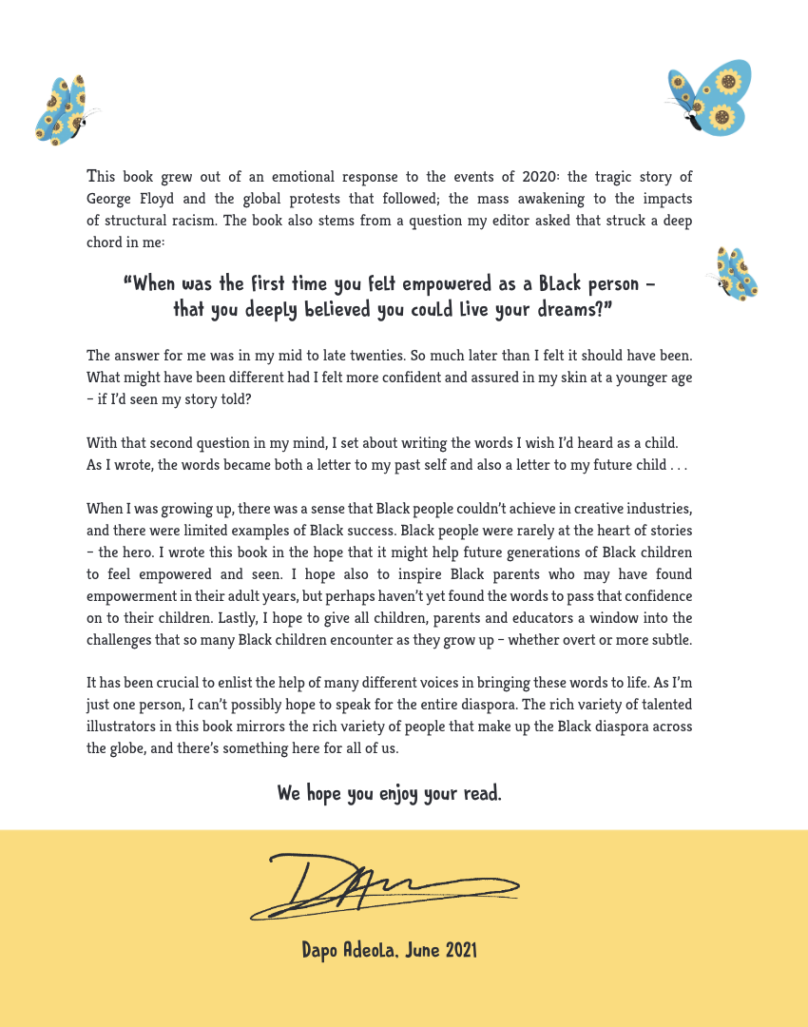
Activity One
Dapo Adeola has written this letter to you, the reader. In it he outlines his reasons for writing Hey You! Read it first in your head, then read it a second time out loud, imagining yourself as Dapo speaking to his audience.
Talk with a partner and together discuss Dapo’s reasons for writing and his hopes for the future. Find words and phrases in the letter to help support your discussion. How do you think he was feeling when he wrote it? Why?
Can you write a short letter back to Dapo outlining your own hopes for future generations? How can you contribute to this dream? Use the following sentence stems to help you:
I hope that …
I dream that one day …
I would like to …
Hey You text © Dapo Adeola, 2021. Typography © Alyissa Johnson, 2021.

Slide 4
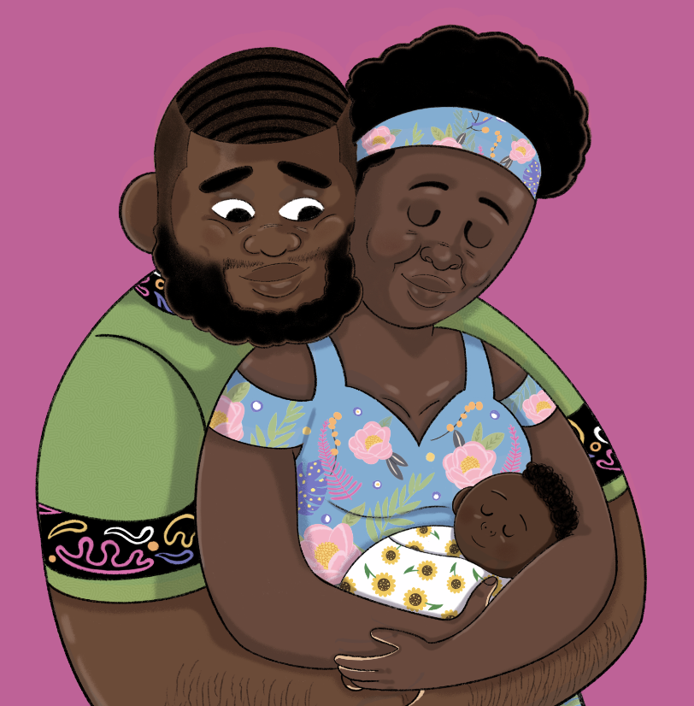
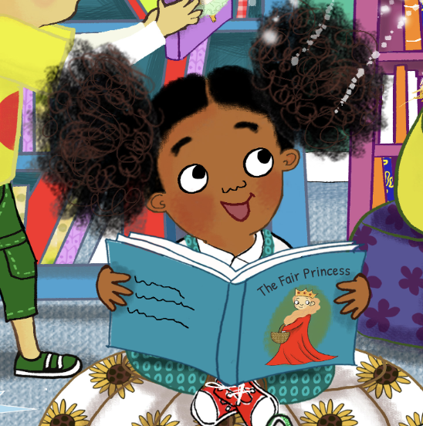
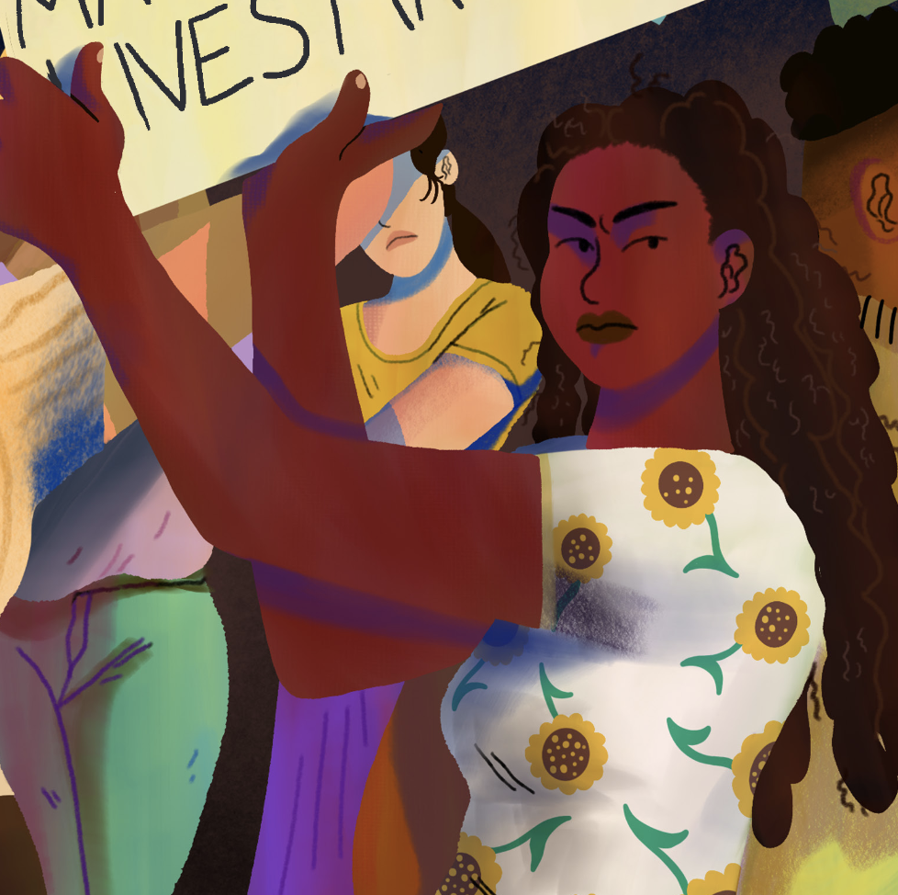
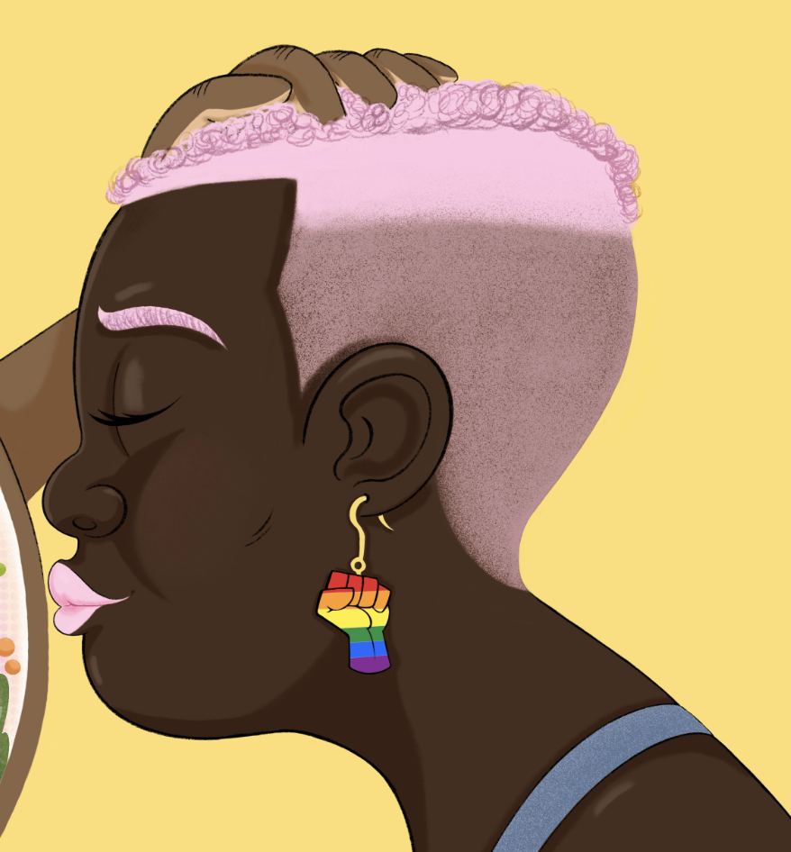
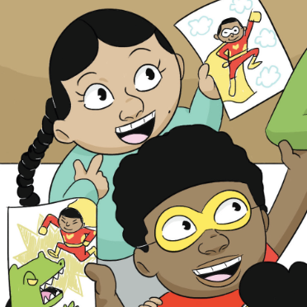
Calm
Excited
Peaceful
Frustrated
Hopeful
Happy
Elated
Angry
Enthusiastic Determined
Sad
Loved
Worried
Reflective
Pensive
Activity Two
Hey You! is full of interesting characters, beautifully illustrated by Dapo and his team of 18 illustrators. The characters are shown in a range of situations and displaying a spectrum of emotions. Some seem happy whilst others look thoughtful and aggrieved.
Look at each of the characters in turn. Can you infer how they are feeling by studying the illustrations? Think about their facial expressions and body language.
Write a paragraph to describe how one of the characters is feeling. Justify your reasons and explain why you think they feel this way. Looking at the spread in the book to view the whole picture and to read the text may help you with this part. You can use the word bank to help you.
Hey You! text © Dapo Adeola, 2021. Illustration © Dapo Adeola, 2021.
Hey You! text © Dapo Adeola, 2021. Illustration © Diane Ewen, 2021.
Hey You! text © Dapo Adeola, 2021. Illustration © Camilla Sucre, 2021.
Hey You! text © Dapo Adeola, 2021. Illustration © Dapo Adeola, 2021.
Hey You! text © Dapo Adeola, 2021. Illustration © Jobe Anderson, 2021.

Slide 5
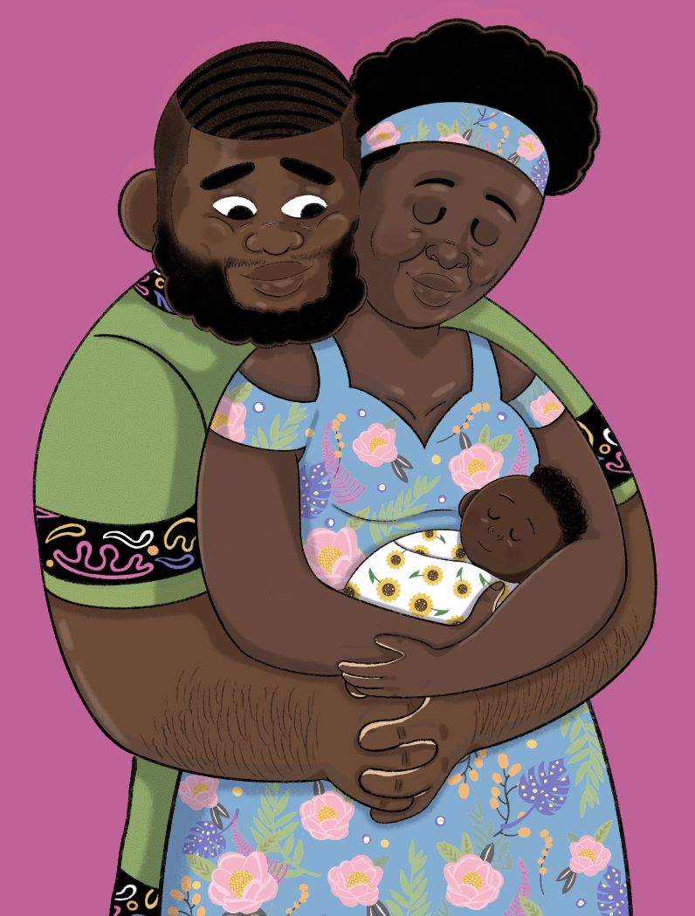
Activity Three
The language in Hey You! is inspiring, hopeful and powerfully evocative. Dapo urges his readers to love themselves and be proud of their own history and ancestors.
Look at the following three words – melanin, culture, heritage - used in the text and check your understanding of them. You could use a dictionary to help you.
What is melanin?
Why do you think it has been
Described as magical?
What do the words culture
and heritage mean? Do they
mean the same thing? Use a
dictionary and discuss.
Now it is time to think about you! Think about your family, your culture and heritage and have a go at celebrating YOU!
Hey You! text © Dapo Adeola, 2021. Illustration © Dapo Adeola, 2021.

Slide 7
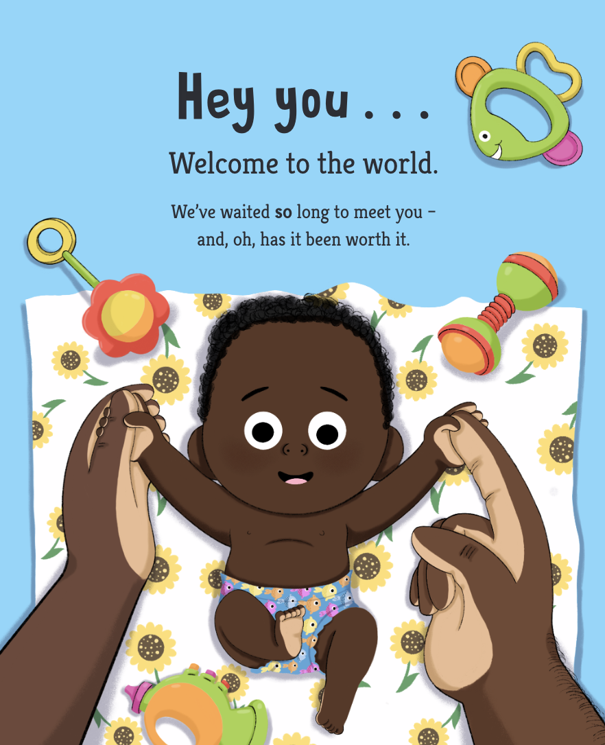
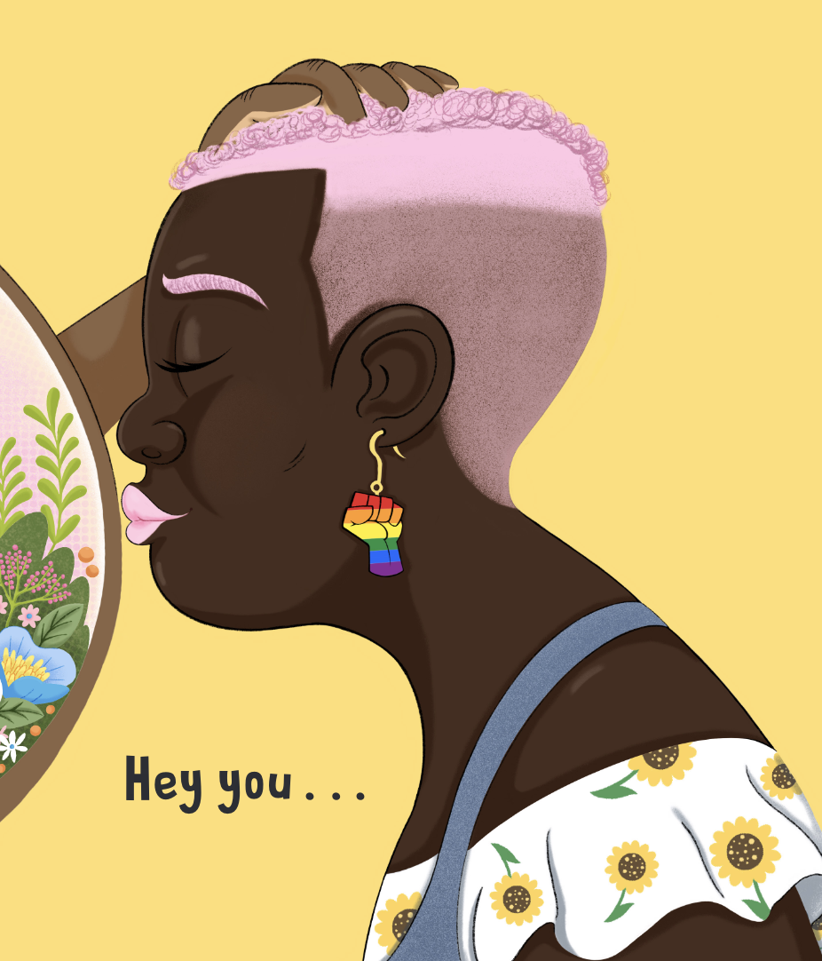
Reflection
The beginning …
The title of this picture book is ‘Hey You!’. Dapo also chose to open and close the book with these two words.
Who is the ‘you’ he is talking to?
Can you spot any similarities between the first and the final spread?
Why do you think Dapo began and ended the book with the same two words? What effect does it have on the reader?
The final ‘hey you’ is followed by an ellipsis but no further text. Why do you think this is?
What do you think might come next?
…the end
Hey You! text © Dapo Adeola, 2021. Illustration © Dapo Adeola, 2021.
Hey You! text © Dapo Adeola, 2021. Illustration © Dapo Adeola, 2021.

Slide 8
penguin.co.uk/litincolour

