Slide 1
KS1/2 PSHE
Hey You!
By Dapo Adeola and eighteen talented Black illustrators:
Hey You! cover illustration © Dapo Adeola, 2021. Typography © Alyissa Johnson, 2021.
Alyissa Johnson
Jade Orlando
Reggie Brown
Chanté Timothy
Sharee Miller
Diane Ewen
Onyinye Iwu
Gladys Jose
Bex Glendining
Dunni Mustapha
Charlot Kristensen
Camilla Sucre
Jobe Anderson Joelle Avelino Nicole Miles Kingsley Nebechi Derick Brooks
Selom Sunu

Slide 2
Activities
Activity One – Design a placard
Use spread 14 to discuss the Black Lives Matter Movement and design your own protest placard.
Activity Two – Create a fact file
Use spread 5 to discuss and create a fact file on one the ‘greats’, and identify the people who have had a positive influence in your life.
Activity Three – Create a hands of diversity display
Inspired by spread 4 – celebrate the diversity in your class by creating a hands of diversity display.
Hey You! cover illustration © Dapo Adeola, 2021. Typography © Alyissa Johnson, 2021.

Slide 3
Hey You! text © Dapo Adeola, 2021. Illustration © Camilla Sucre, 2021.

Slide 4
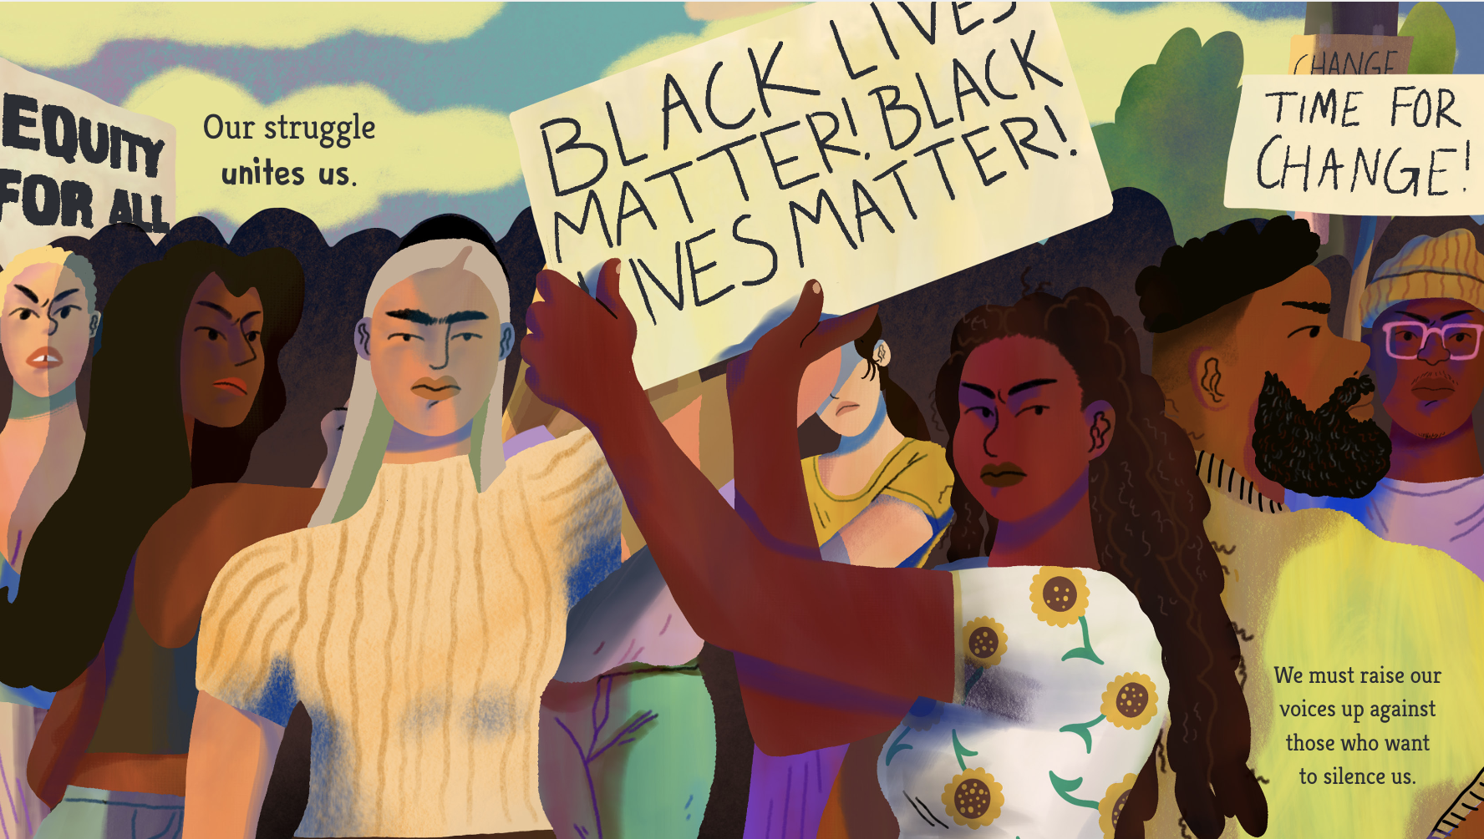
Black Lives Matter!
In the summer of 2020, the Black Lives Matter movement grew in response to the horrific murder of American citizen George Floyd and other racist incidents.
Many people from all over the world united to fight for equity and equality. Many protests occurred to try to stop the mistreatment and discrimination of people based on the colour of their skin.
But remember: ‘every skin colour has its own unique beauty’
Hey You! text © Dapo Adeola, 2021. Illustration © Camilla Sucre, 2021.
What is a protest?
A protest is when people get together to show that they object to something. It is a way of complaining about an act, an idea or way of doing things. Usually protests are peaceful.
Think, Discuss, Share: What does
‘Black Lives Matter’ mean to you?

Slide 5
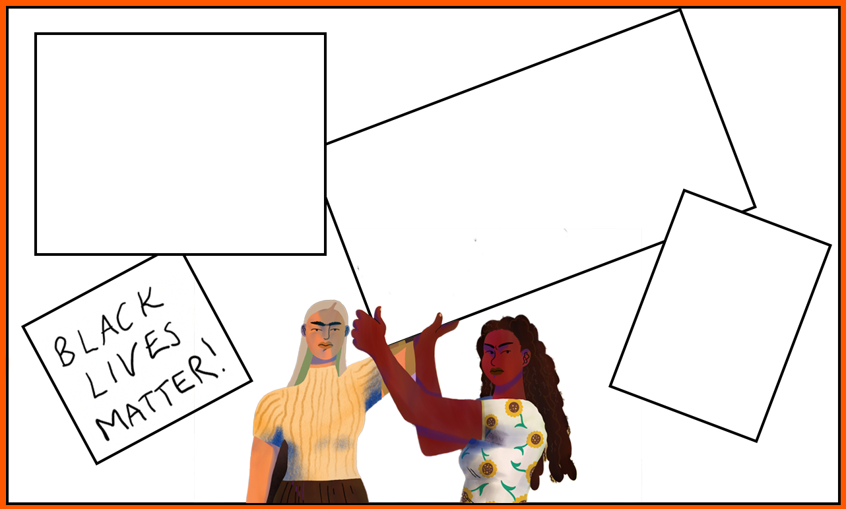
Activity One
Design a Placard
Using spread 14 from Hey You! as inspiration and drawing on what you know about the Black Lives Matter movement, can you think of some social messages you could write on the blank banner templates. Think about the thoughts and feelings you wish to convey. You may want to add other protestors and the background too.

Slide 7
Hey You! text © Dapo Adeola, 2021. Illustration © Onyinye Iwu, 2021.

Slide 8
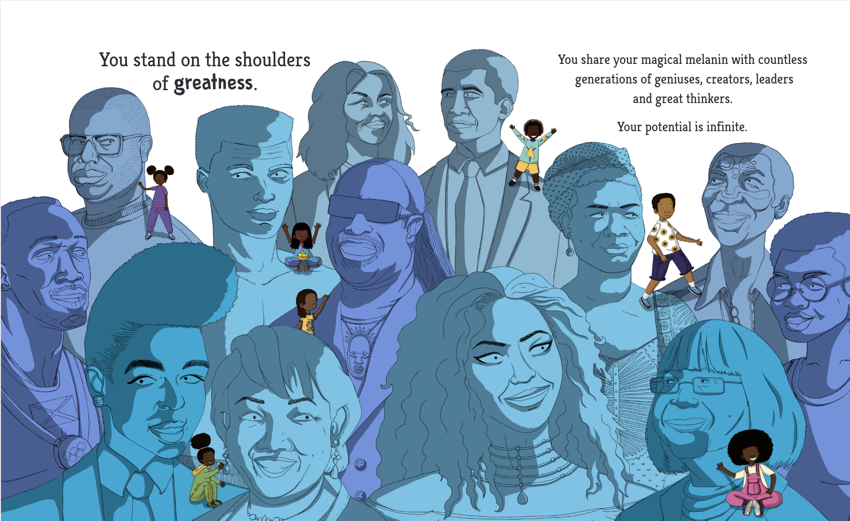
The Shoulders of Greatness
How many of the ‘greats’ in the illustration can you identify?
Can you explain why they have been given the honour of being called great?
Turn to the back of the book to help you if you get stuck. This is more than just an illustration – this is a history lesson in an image!
Hey You! text © Dapo Adeola, 2021. Illustration © Onyinye Iwu, 2021.
Think, Discuss, Share: Think about your family and friends from generations above you. How have they positively influenced your life? How have they helped you achieve? Who are your ‘greats’?

Slide 9
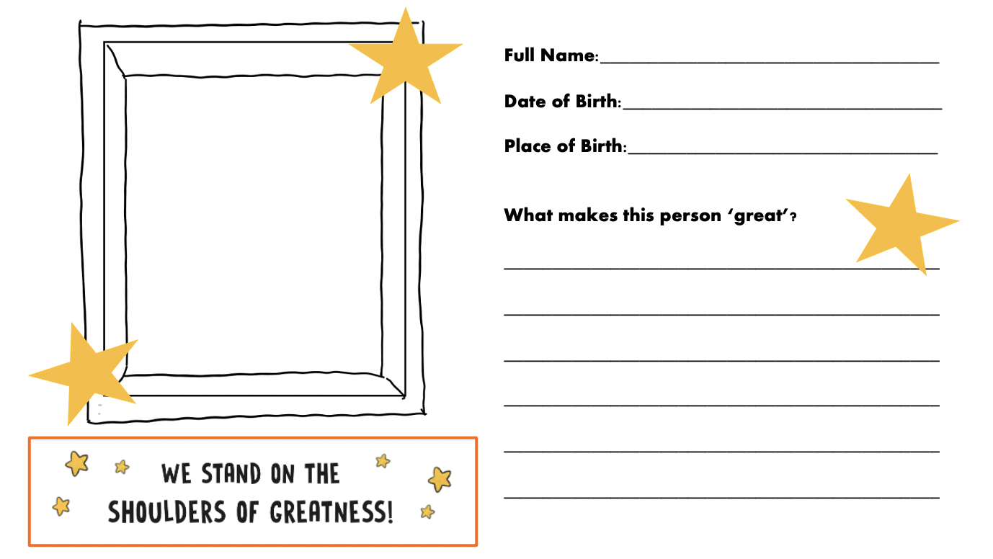
Activity Two
Create a fact file
Choose one of the ‘greats’ in the illustration by Onyinye Iwu.
Using the information in the back of Hey You! alongside other research material complete the blank fact file template. You may even have an idea for another ‘great’ you may wish to find out about. Maybe your ‘great’ is closer to home and could be a family member, a friend or another positive influence in your life.

Slide 11
Hey You! text © Dapo Adeola, 2021. Illustration © Reggie Brown, 2021.

Slide 12
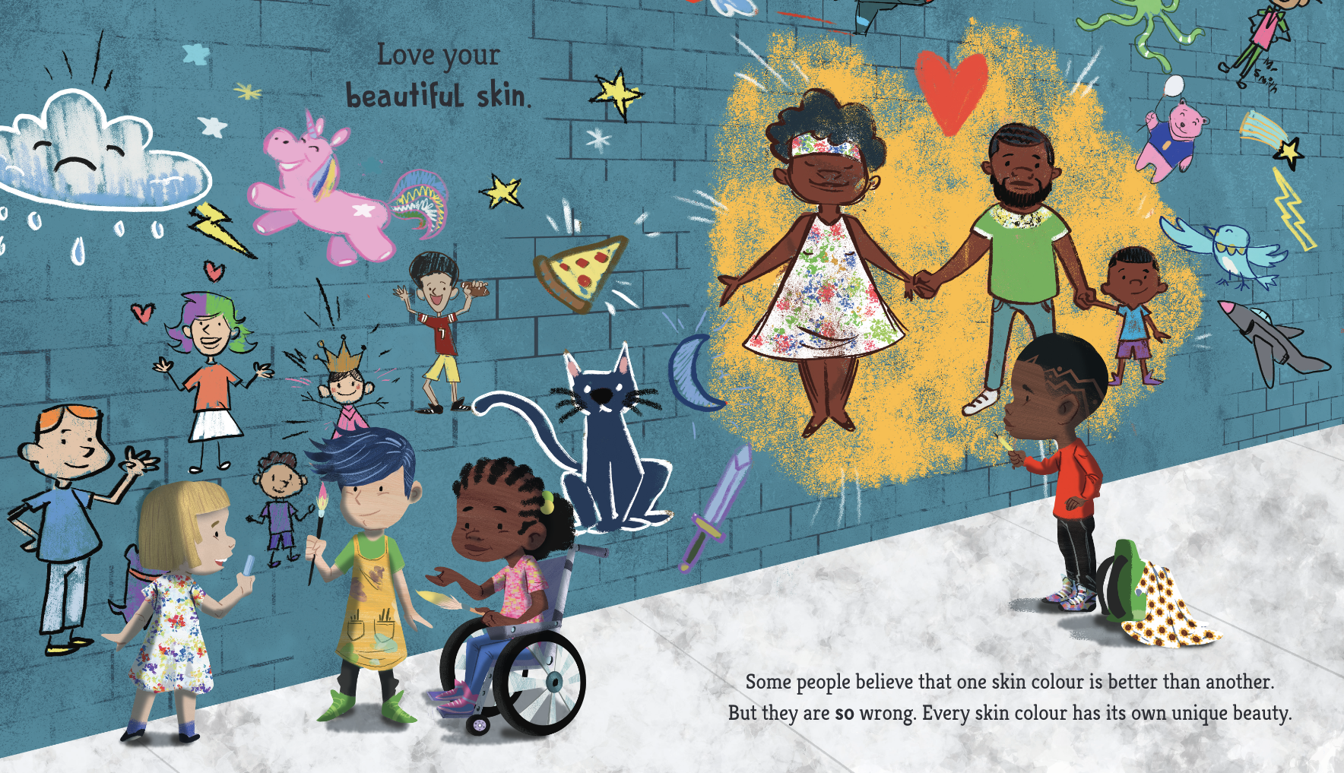
Hands of Diversity
Throughout the book Dapo urges you to ‘love your beautiful skin’ because ‘every skin colour has its own unique beauty’.
Look at your own hands, study your fingers, your nails, your skin, your finger prints – they are unique to you! Now look in a mirror and have a close look your face. Study your details, those that make you YOU! You are unique and wonderful. There is only one you in the whole wide world and you need to love and look after yourself. Be proud of who you are and celebrate your identity.

Slide 13
Activity Three
Create a Hands of Diversity Display
Draw around your hand and cut it out carefully. On each finger write a sentence to celebrate your uniqueness. Colour around your sentences using pencils or you could mix your skin tone out of paint and decorate around your sentences using it. Once complete, display your hand alongside those of your friends to share your wonderful identities with anyone who walks by.
Sentence stems
I am good at… I am special because…
I love the way I… I like my… because…

Slide 14
penguin.co.uk/litincolour

